Slide 1
dextermiller.com
Major: B.S. Computer Science
Minor: Mathematics
Indiana Tech

Slide 2
Project Summary
What project does
This project is a website, in and of itself, it communicates who I am and what I can do
Why chosen – what need does it fulfill
It was build to show my skills, professionalism, and the fundamentals of an AI.
The fundamentals of AI Implemented through

Slide 3
Overview
Why
I’ve programmed tic-tac-toe and connect4 before in C++ but now I want to build upon it.
I wanted to add an AI to play against.
I wanted to build a website.
What
Tic-tac –toe
Connect 4
Ubuntu Server

Slide 4
Analysis & Design
Algorithms
Minimax
Pruning

Slide 5
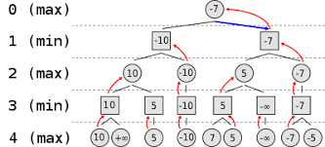
Minimax Algorithm

Slide 6
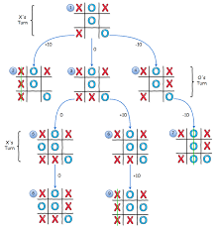
Minimax cont.

Slide 7
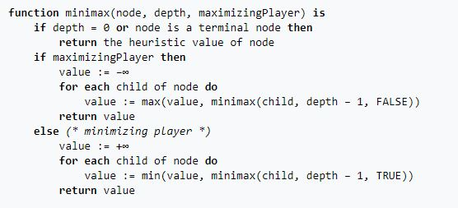
Minimax Pseudocode

Slide 8
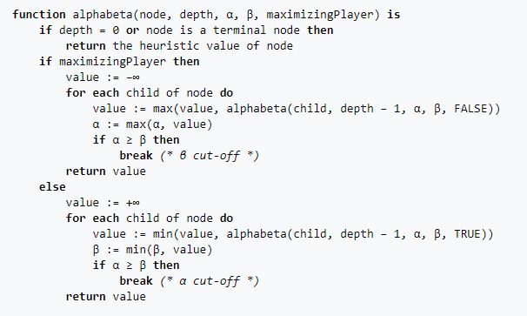
Alpha-beta pseudocode

Slide 9
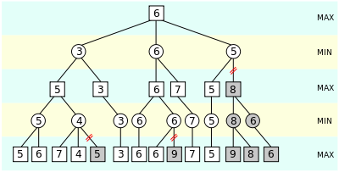
Alpha-beta cont.

Slide 10
Testing
Playing the game!

Slide 11
Testing/Data
Tic-Tac-Toe (Minimax)
Moves on board | Iterations | Average Time (ms)
1 | 549,946 | 211.765
2 | 59,705 | 22.5775
3 | 7332 | 2.694166
4 | 935 | 0.364166
5 | 198 | 0.101667
6 | 47 | 0.13
7 | 14 | 0.024167
8 | 5 | 0.01
9 | 2 | 0.008333

Slide 12
Testing/Data
Connect 4 (Minimax)
Moves on board | Iterations | Average Time (ms)
1 | 137257 | 981.1533
2 | 137256 | 869.0908
3 | 135743 | 853.895
4 | 137218 | 859.4117
5 | 135669 | 896.1308
6 | 134385 | 848.8608
7 | 130637 | 851.21
8 | 131334 | 851.8733
9 | 125387 | 840.0525
Averages | 133876.2 | 872.4087
Connect 4 (Alpha-Beta)
Moves on board | Iterations | Average Time (ms)
1 | 9007 | 150.1833
2 | 12769 | 99.235
3 | 7628 | 57.44
4 | 9415 | 54.16
5 | 9065 | 75.85
6 | 7585 | 43.79833
7 | 8542 | 48.4275
8 | 8246 | 48.69667
9 | 9214 | 54.5475
Average | 9052.33 | 70.25981
Notes:
That’s a 93.238% change!

Slide 13
Demonstration
dextermiller.com

Slide 14
Citations

Slide 15
Questions

